Slide 1

MTHM017 Advanced Topics Workshop A
Dr John T Bruun

Slide 2
Workshop Task
This and next week we are looking at how we implement and compute the Bayesian statistics and inference properties. You will explore how we code and run the lecture examples plus more. We run this from the R package. You need both RStudio and JAGS installed onto your machines. The CEMPS Digital Learning Developers can help you if you have any specific install questions (MathsDLD@exeter.ac.uk).
Bayesian computation enables us to resolve and calculate sophisticated probability problems. In some, and especially text book cases, these can be worked out exactly via algebra. However for a wide range of non-regular inference problems it is not always possible to find the answers analytically. Since the availability of high volume computation over the last 50 years, stochastic sampling algorithms have become a useful tool. With this Bayesian techniques have been developed that enable us to solve these probability questions to a very high level of accuracy.
To explore these you should familiarise yourself with coding and running the lecture examples explained in the first week. These are reproduced here in R Markdown.With the focus on communication and developing these skills the module is assessed with three course works (submission is planned via ELE):

Slide 3
Below is the script coding.
To build your coding experience use this to become familiar with:
a) how to use this code as is and to reproduce the lecture note results.
b) Use the help()facility to look at the additional settings you can alter in jags(), especially the number of chains, number of iterations and burn length.
Examine how the standard results for the coin and drug examples vary when the sampling chains become too small. Practicing this and building understanding of how to look for convergence to a stable result are an essential aspect of using these advanced probability tools.
c) For debug and finished analysis you can 'set the seed' and let it run freely. Discuss in your breakout groups and show each other the differing results you obtain when it runs freely. Alter the chain length to compare notes.
d) Once you are familiar with a) - c) practice altering the jags.mod() and the data values.
e) Discuss in your teams what you have learnt from this workshop and be prepared to share feedback towards the end of the session with your co-students. Aim to rotate this to give opportunity for as many of you to explain and to learn from each other.

Slide 4
1) Firstly load in a range of libraries
```{r}
library(R2jags)
library(MCMCvis)
library(tidyverse)
library(TSA)
library(coda)
library(ggplot2)
library(lattice)
```
We focus on using rjags. As explained in the notes - this is a way to run the JAGS/BUGS functionality- from within R. This technology is relatively recent, and it makes the Bayesian inference much easier to combine with other R based analyses. This is state-of-the-art functionality and you are fortunate to be learning Bayes things this way.

Slide 5
2) Coin toss example from Lecture 1. a) Setting the jags.mod term. b) Set the seed (uncomment to fix this). c) Running the jags analysis. d) Print the result output.
```{r}
# a) Lecture notes code
jags.mod <- function(){
Y ~ dbin(0.5,10)
P8 <- ifelse(Y>7,1,0)
}
```
```{r}
# b) set.seed(2)
```
```{r}
# c) run the analysis (here is where you change the burn and iterations)
jags.mod.fit <- jags(data = list(), model.file = jags.mod,
parameters.to.save = c("Y","P8"),
DIC=FALSE, n.chains = 3,n.iter = 50)
#,n.burnin=50)
```
```{r}
# d) Print the jags results
jags.mod.fit
```

Slide 6
2) Coin toss example from Lecture 1. a) Setting the jags.model. b) Set the seed (uncomment to fix this). c) Running the jags analysis. d) Print the result output.
```{r}
# d) Print the jags results
jags.mod.fit
```
Example output:
Inference for Bugs model at "C:/Users/jb1033/AppData/Local/Temp/RtmpuYEK5x/model42b835191b6b.txt", fit using jags,
3 chains, each with 50 iterations (first 25 discarded)
n.sims = 75 iterations saved
mu.vect sd.vect 2.5% 25% 50% 75% 97.5% Rhat n.eff
P8 0.027 0.162 0 0 0 0 0.15 1.090 75
Y 4.947 1.374 2 4 5 6 7.15 0.992 75

Slide 7
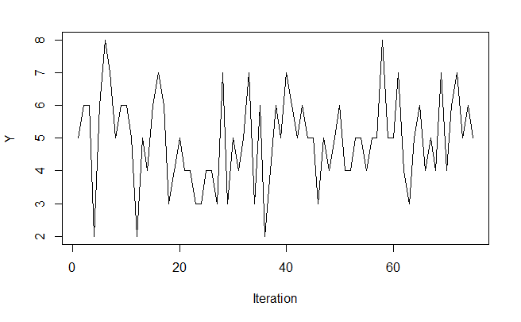
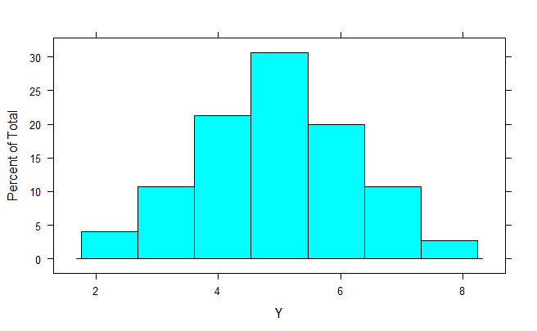
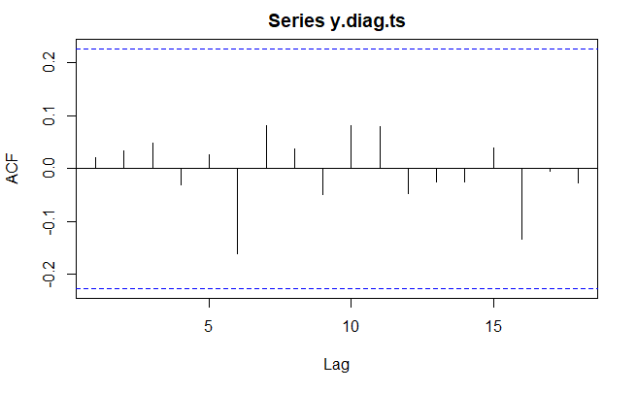
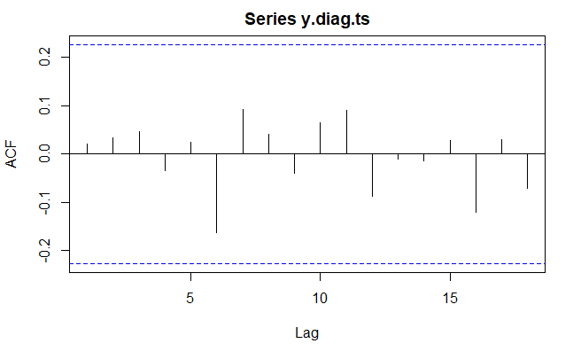
Diagnostics: Look at the chain output for Y. Firstly extract the chain record and also map this into a time series object. Here histogram, chain time series record together with auto and partial correlation are explored. What do the acf terms help us to assess?
```{r}
y.diag <- jags.mod.fit$BUGSoutput$sims.list$Y
y.diag.ts <- ts(y.diag)
histogram(y.diag,xlab="Y",plot=TRUE)
ts.plot(y.diag.ts,xlab="Iteration",ylab="Y")
acf(y.diag.ts)
acf(y.diag.ts,type="partial")
```

Slide 8
Diagnostics: Now, as for before, look at the chain output for P8
```{r}
P8.diag <- jags.mod.fit$BUGSoutput$sims.list$P8
P8.diag.ts <- ts(P8.diag)
histogram(P8.diag,xlab="Y",plot=TRUE)
ts.plot(P8.diag.ts,xlab="Iteration",ylab="Y")
acf(P8.diag.ts)
acf(P8.diag.ts,type="partial")
```
Examine how altering the number of iterations, number of chains and burn alter the accuracy and potential biases of the result for both Y and P8.

Slide 9
2) The drug assessment example from Lecture 1 and 2. Assign the model and run jags. Note how the data numbers are hard coded into this: why can this be problematic in a practical sense?
```{r}
# Assign the beta-binomial model relationship.
jags.mod <- function(){
theta ~ dbeta(9.2,13.8)
y ~ dbin(theta,20)
P.crit <- ifelse(y>=15,1,0)
}
```
```{r}
# Run the jags analysis
jags.mod.fit <- jags(data = list(), n.iter = 1000,n.chains=10,
DIC=FALSE,parameters.to.save =
c("theta","y","P.crit"),
model.file = jags.mod)
```

Slide 10
Print the jags results:
```{r}
print(jags.mod.fit)
```
Inference for Bugs model at "C:/Users/jb1033/AppData/Local/Temp/RtmpuYEK5x/model42b846d278c.txt", fit using jags,
10 chains, each with 1000 iterations (first 500 discarded)
n.sims = 5000 iterations saved
mu.vect sd.vect 2.5% 25% 50% 75% 97.5% Rhat n.eff
P.crit 0.014 0.117 0.000 0.000 0.000 0.000 0.000 1.003 5000
theta 0.399 0.099 0.216 0.328 0.394 0.466 0.601 1.002 3200
y 8.003 2.918 3.000 6.000 8.000 10.000 14.000 1.002 2800
For each parameter, n.eff is a crude measure of effective sample size,
and Rhat is the potential scale reduction factor (at convergence, Rhat=1).

Slide 11
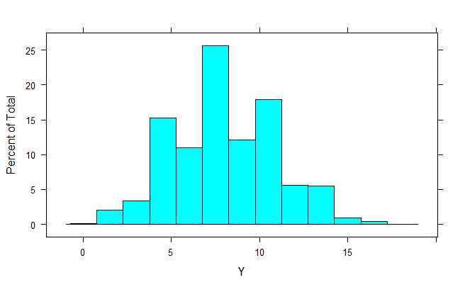
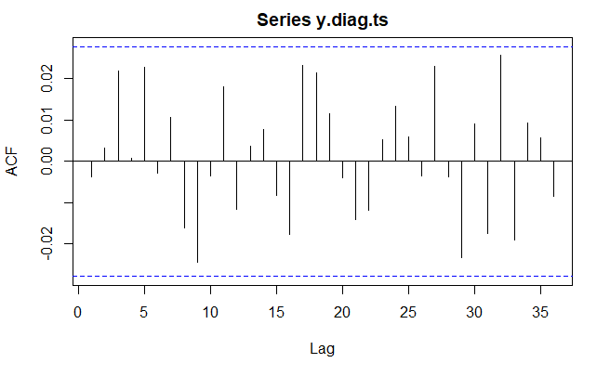
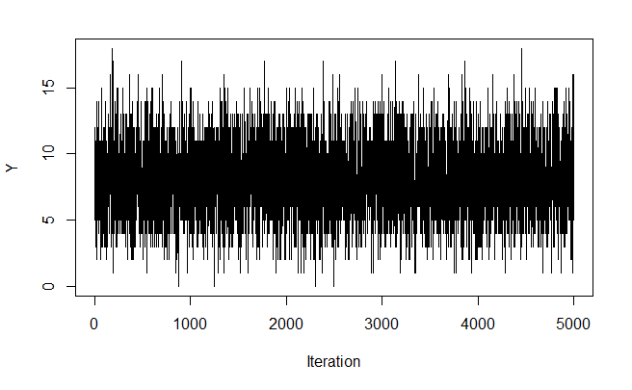
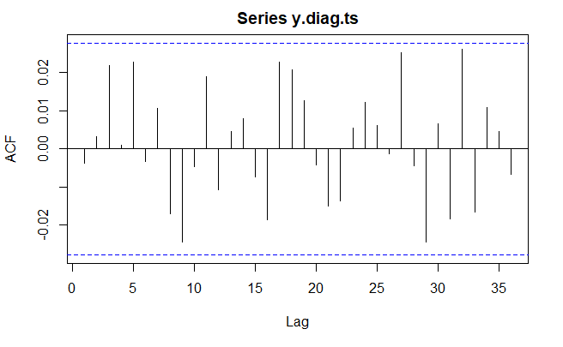
Show the diagnostics (as above). Try altering the above code for differing chains and iteration lengths to see how the results and diagnostics alter. Discuss this with your Breakout Group colleagues.
```{r}
y.diag <- jags.mod.fit$BUGSoutput$sims.list$y
y.diag.ts <- ts(y.diag)
histogram(y.diag,xlab="Y",plot=TRUE)
ts.plot(y.diag.ts,xlab="Iteration",ylab="Y")
acf(y.diag.ts)
acf(y.diag.ts,type="partial")
```

Slide 12
Show the diagnostics (as above). Try altering the above code for differing chains and iteration lengths to see how the results and diagnostics alter. Repeat for P and theta
Diagnostics for p
```{r}
p.diag <- jags.mod.fit$BUGSoutput$sims.list$P.crit
p.diag.ts <- ts(p.diag)
histogram(p.diag,xlab="P Crit",plot=TRUE)
ts.plot(p.diag.ts,xlab="Iteration",ylab="P Crit")
acf(p.diag.ts)
acf(p.diag.ts,type="partial")
```
Diagnostics for theta:
```{r}
theta.diag <- jags.mod.fit$BUGSoutput$sims.list$theta
theta.diag.ts <- ts(theta.diag)
histogram(theta.diag,xlab="theta",plot=TRUE)
ts.plot(theta.diag.ts,xlab="Iteration",ylab="Theta")
acf(theta.diag.ts)
acf(theta.diag.ts,type="partial")
```

Slide 13
From Lecture 2, this is how to code the model more generically
```{r}
# model
jags.mod <- function(){
theta ~ dbeta(a,b) # prior disribution
y ~ dbin(theta,n) # sampling distribution
y.pred ~ dbin(theta,m) # predictive distribution
P.crit <- ifelse(y.pred>=ncrit,1,0) # =1 if y.pred >= ncrit, 0 o/w
}
```
The data are passed into this model via the jags() command with a list(). Explain why y = 15 here?
```{r}
# data
a=9.2; b=13.8
y=15
n=20; m=40
ncrit=25
jags.data <- list("a","b","y","n","m","ncrit")
```

Slide 14
This is how we define the parameters of interest, for the jags()command.
```{r}
# Parameters we want to monitor
jags.param <- c("theta","y.pred","P.crit")
```
Initial data values are set with this:
```{r}
# Specify initial values
jags.inits <- function(){
list("theta" = 0.7, "y.pred" = 20)
}
```
Run jags(). Again explore differing chain numbers and iteration lengths.
```{r}
# Fit the JAGS model
# n.iter = number of samples to be drawn
# n.burnin = number of samples to discard
# (that is we won't use these in the analysis)
jags.mod.fit <- jags(data = jags.data, inits = jags.inits,
parameters.to.save = jags.param,n.chain=10,
n.iter = 10000, model.file = jags.mod,n.thin=1)
```

Slide 15
Print results. Go into the command window to advance the traceplot functions by pressing return when asked.
```{r}
print(jags.mod.fit)
traceplot(jags.mod.fit)
```
Inference for Bugs model at "C:/Users/jb1033/AppData/Local/Temp/RtmpuYEK5x/model42b8418a390f.txt", fit using jags,
10 chains, each with 10000 iterations (first 5000 discarded)
n.sims = 50000 iterations saved
mu.vect sd.vect 2.5% 25% 50% 75% 97.5% Rhat n.eff
P.crit 0.331 0.471 0.000 0.000 0.000 1.000 1.000 1.001 30000
theta 0.563 0.075 0.415 0.512 0.564 0.615 0.706 1.001 29000
y.pred 22.525 4.295 14.000 20.000 23.000 26.000 31.000 1.001 24000
deviance 6.636 2.401 3.391 4.842 6.190 7.945 12.451 1.001 28000
For each parameter, n.eff is a crude measure of effective sample size,
and Rhat is the potential scale reduction factor (at convergence, Rhat=1).
DIC info (using the rule, pD = var(deviance)/2)
pD = 2.9 and DIC = 9.5
DIC is an estimate of expected predictive error (lower deviance is better).

Slide 16
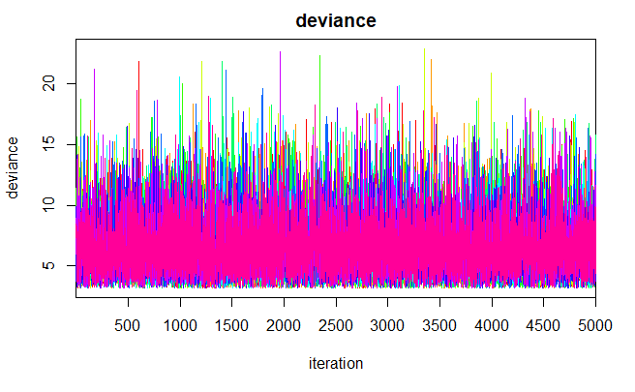
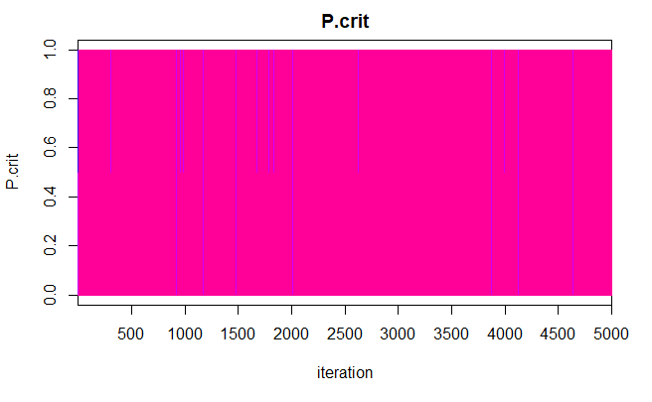
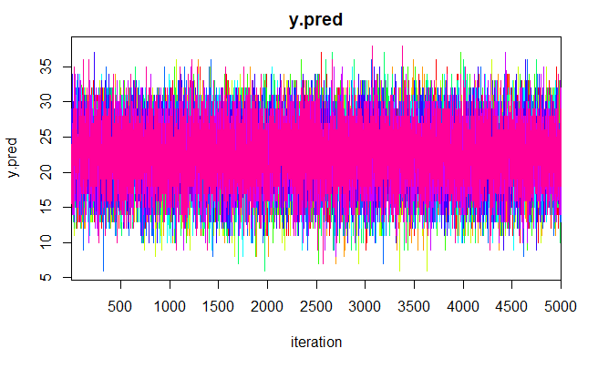
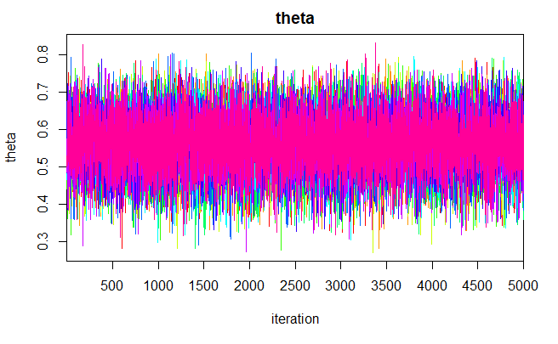
Print results. Go into the command window to advance the traceplot functions by pressing return when asked. Discuss these results…. Any limitations?
```{r}
print(jags.mod.fit)
traceplot(jags.mod.fit)
```

Slide 17
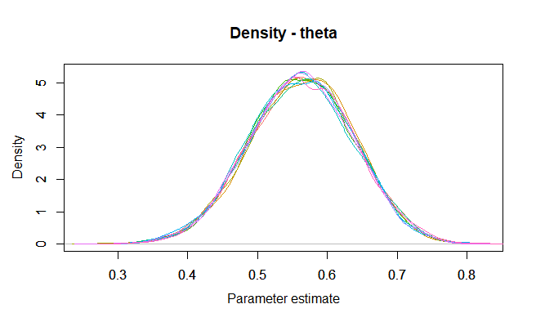
You can plot the theta interval property with this Monte Carlo Markov Chain code extension. What does MCMC do - discuss.
```{r}
jagsfit.mcmc <- as.mcmc(jags.mod.fit)
MCMCtrace(jagsfit.mcmc,
params = 'theta',
type = 'density',
ind = TRUE,
pdf = FALSE)
```

Slide 18
To conclude
Use these examples to become confident at running the jags()command and explore how far you can stretch the chain.
The help()is your programming friend – use it regularly to see what options you have.
Next week we will build on this with a second Workshop on these Bayesian computation methods.

